Slide 1

Welcome to CS106B: Programming Abstractions!
Where in the world are you right now?
(put your answers in the chat)

Slide 2
Who are we?

Slide 3



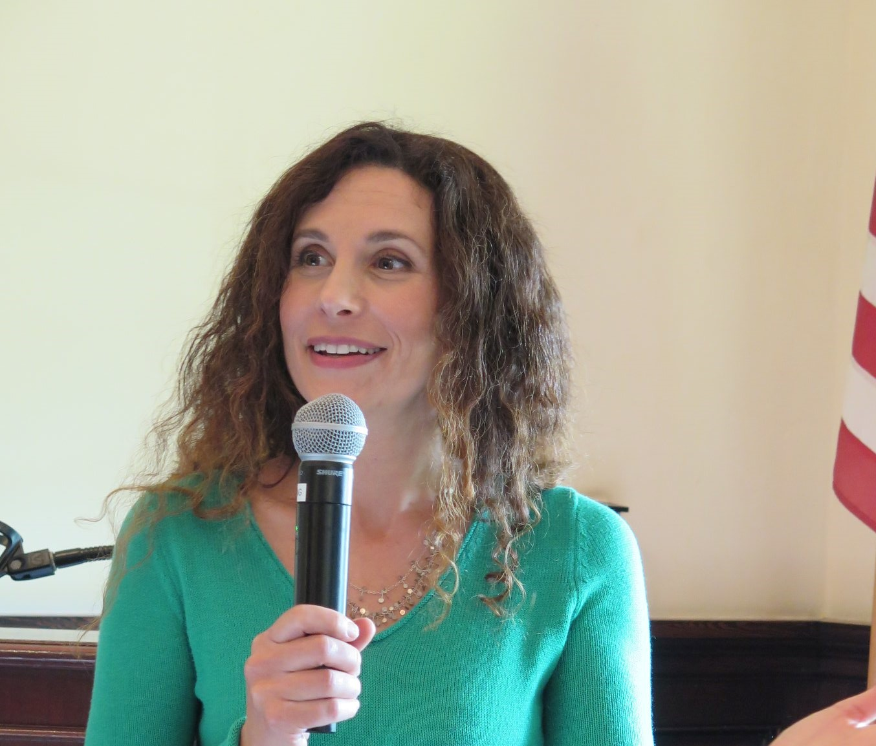
Susan Epstein Lecturer

Slide 4

Trip Master Head TA
–

Slide 5

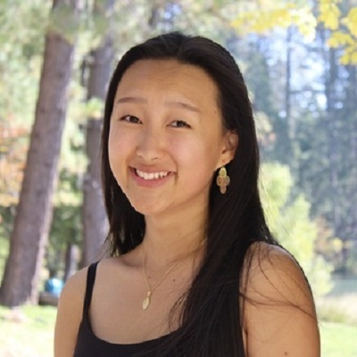

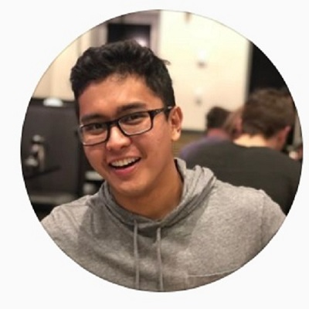
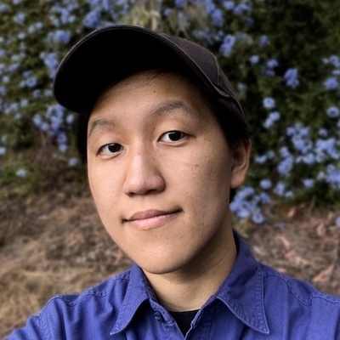
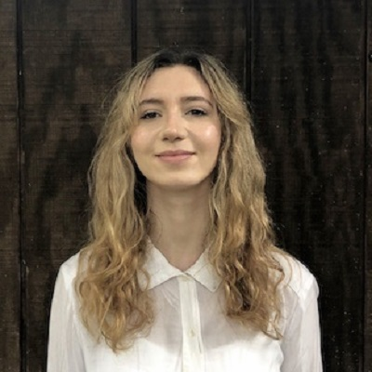
Section Leaders
Frankie
Jin-Hee
Grant
Jose
Ryan
Ayelet

Slide 6
Please feel free to use the Q&A feature on Zoom to ask Qs.
Please do not answer other students’ Qs in the chat.
The course staff will respond to Qs.

Slide 7
Who are you?

Slide 8
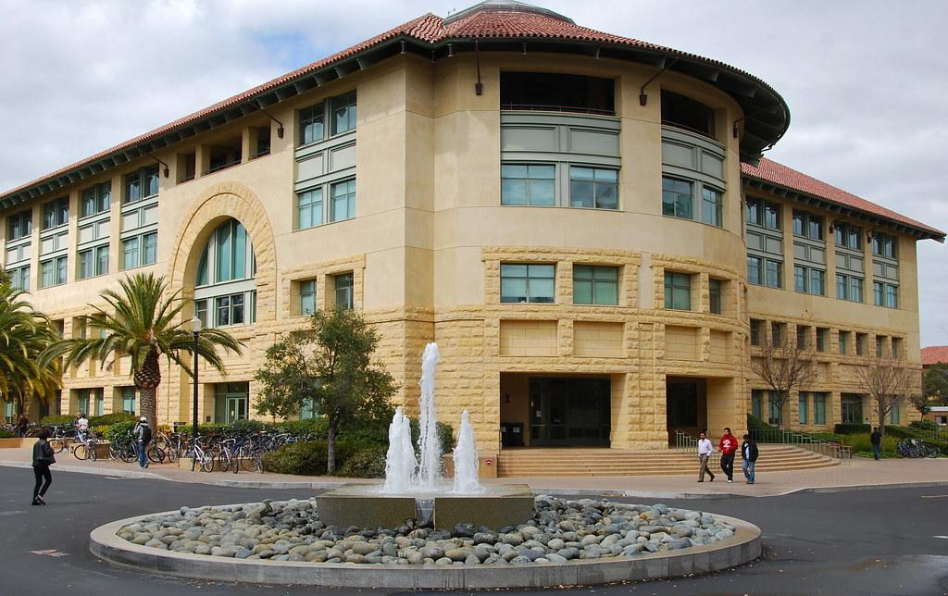
CS106B has been taught at Stanford for more than 30 years.
Today’s lecture blends materials created by Keith Schwartz, Chris Piech, Kylie Jue, and Nick Bowman. Many of the course assignments were created by Julie Zelenski and Chris Gregg.
Gates Computer Science Building, Stanford

Slide 9
Prerequisites
CS106A or a similar course
Read the course placement guide on the class website.

Slide 10
Today’s questions
Why take CS106B?
What is an abstraction?
What is CS106B?
Why C++?
What’s next?

Slide 11
Why take CS106B?

Slide 12
What CS106B is
Logical follow-up course to an introductory CS class
Practice with computational thinking skills through basic C++ coding
Survey of data structures and algorithms

Slide 13
What CS106B is not
A course to teach you how to program from scratch
A course that will teach you the specifics of the C++ language

Slide 14
Aero/Astro
African / Afro-American Studies
Bioengineering
Biology
Business
Chemical Engineering
Chemistry
Civil and Environmental Engineering
Classics
Computer Science
Creative Writing
Earth Systems
Economics
Education
Electrical Engineering
Energy Resource Engineering
English
Environmental Systems Engineering
Environment and Resources
Ethics in Society
Geophysics
Human Biology
Immunology
Individually-Designed
International Policy
International Relations
Law
Linguistics
Management Science and Engineering
Materials Science and Engineering
Mathematical and Computational Science
Mathematics
Mechanical Engineering
Music
Physics
Psychology
Public Policy
Science, Technology, and Society
Sociology
Symbolic Systems
Theater and Performing Studies
Undeclared!

Slide 15
Goals for this Course
Learn how to model and solve complex problems with computers.
Explore common abstractions for representing problems.
Harness recursion and understand how to think about problems recursively.
Analyze different approaches for solving problems: efficiency, optimization, and ethics.

Slide 16
Goals for this Course
Learn how to model and solve complex problems with computers.
Explore common abstractions for representing problems.
Harness recursion and understand how to think about problems recursively.
Analyze different approaches for solving problems: efficiency, optimization, and ethics.

Slide 17

http://www.publicdomainpictures.net/pictures/10000/velka/1-1265899974oKJ9.jpg
Slide courtesy of Keith Schwartz

Slide 18
Slide courtesy of Keith Schwartz
http://www.publicdomainpictures.net/pictures/10000/velka/1-1265899974oKJ9.jpg

Slide 19
Sentence
Subject
Verb Phrase
Object
Noun
Adverb
Verb
Possessive
Noun
CS106B
totally
rocks
my
socks
Slide courtesy of Keith Schwartz

Slide 20
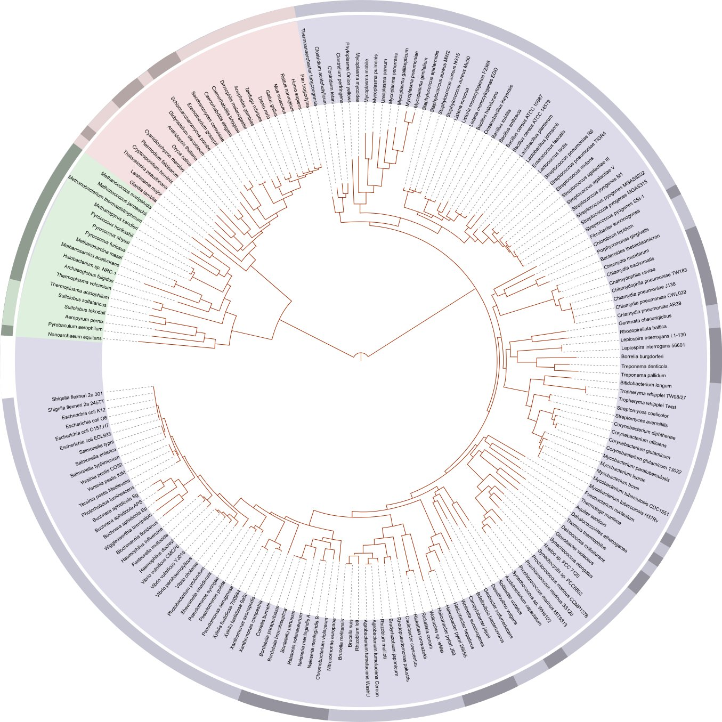
Hey, that's us!
Slide courtesy of Keith Schwartz
http://en.wikipedia.org/wiki/File:Tree_of_life_SVG.svg

Slide 21
This structure is called a tree. Knowing how to model, represent, and manipulate trees in software makes it possible to solve interesting problems.
Slide courtesy of Keith Schwartz

Slide 22
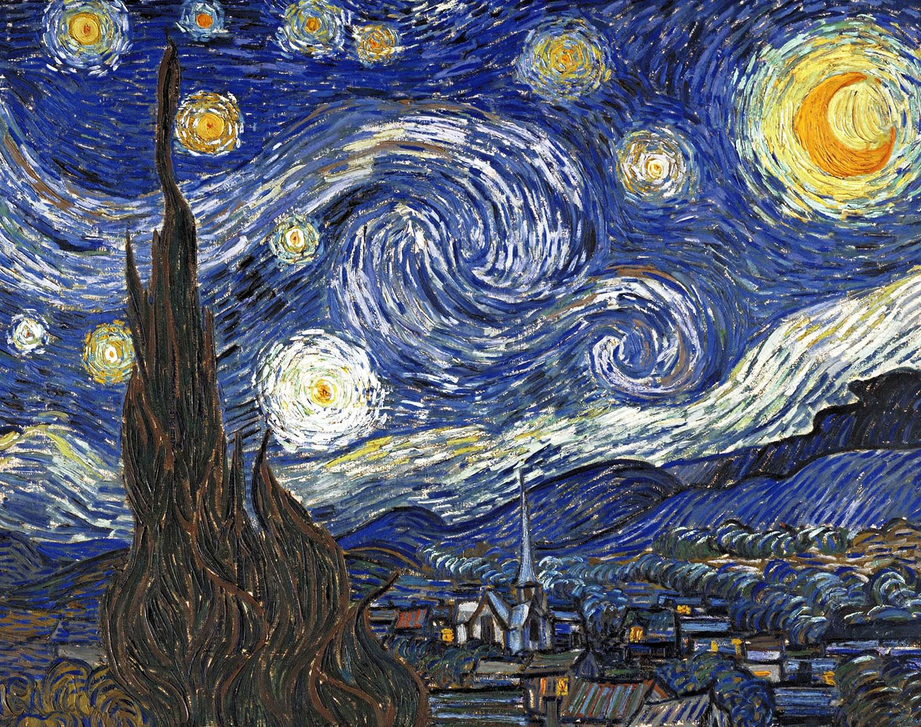


An abstraction is a design that hides the details of how something works while still allowing the user to access complex functionality.
Slide courtesy of Kylie Jue & Nick Bowman

Slide 23
Building a vocabulary of abstractions
makes it possible to represent and solve a wider class of problems.

Slide 24
Goals for this Course
Learn how to model and solve complex problems with computers.
Explore common abstractions for representing problems.
Harness recursion and understand how to think about problems recursively.
Analyze different approaches for solving problems: efficiency, optimization, and ethics.

Slide 25
Goals for this Course
Learn how to model and solve complex problems with computers.
Explore common abstractions for representing problems.
Harness recursion and understand how to think about problems recursively.
Analyze different approaches for solving problems: efficiency, optimization, and ethics.

Slide 26

http://www.marketoracle.co.uk/images/2010/Oct/fractal-tree2.jpg

Slide 27
http://www.marketoracle.co.uk/images/2010/Oct/fractal-tree2.jpg

Slide 28
http://www.marketoracle.co.uk/images/2010/Oct/fractal-tree2.jpg

Slide 29
http://www.marketoracle.co.uk/images/2010/Oct/fractal-tree2.jpg

Slide 30
A recursive solution is a solution that is defined in terms of itself.

Slide 31
Goals for this Course
Learn how to model and solve complex problems with computers.
Explore common abstractions for representing problems.
Harness recursion and understand how to think about problems recursively.
Analyze different approaches for solving problems: efficiency, optimization, and ethics.

Slide 32
Goals for this Course
Learn how to model and solve complex problems with computers.
Explore common abstractions for representing problems.
Harness recursion and understand how to think about problems recursively.
Analyze different approaches for solving problems: efficiency, optimization, and ethics.

Slide 33
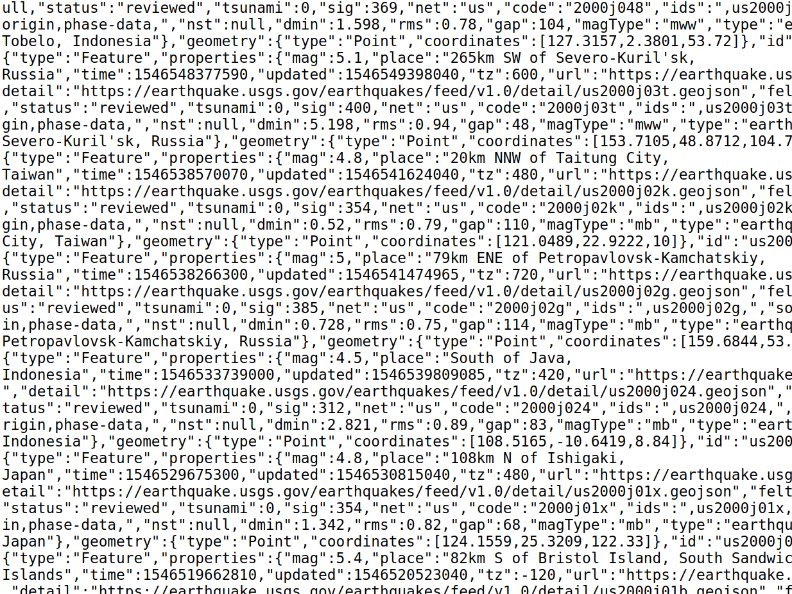

Slide 34
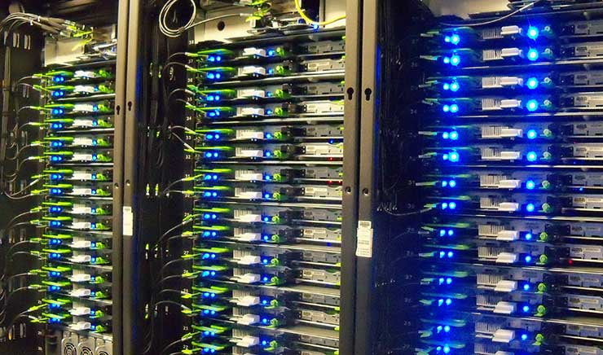
Source: https://datacenterfrontier.com/year-hyperscale-facebook-growth-innovation/

Slide 35
There are many ways to solve the same problem.
How do we quantitatively talk about how they compare?
What might be the unintentional impacts of a solution?
Who will benefit? Will anyone be harmed?
How will we be able to test our solution and measure its efficacy against our goals?
Who should be invited into the design process?

Slide 36
What is CS106B? (the nuts and bolts)

Slide 37
How will we be using and making abstractions?
Programming languages are abstractions through which we communicate with computers.
Users are able to take full advantage of a complex system without needing to know how it works or how it was made because of a simple interface.
CS106B focuses on the use and design of abstractions in computer science.

Slide 38
Moving across the “abstraction boundary”
Your journey into learning abstractions will be like learning to cook.

Slide 39
Moving across the “abstraction boundary”
Your journey into learning abstractions will be like learning to cook.
You start off by using other people’s recipes – tools that others have created to make it easy to prepare food and ensure you have sustenance.

Slide 40
Moving across the “abstraction boundary”
Your journey into learning abstractions will be like learning to cook.
You start off by using other people’s recipes – tools that others have created to make it easy to prepare food and ensure you have sustenance.
Some of these recipes (tools) are better than others, and you learn how to evaluate them and use them in ways that work best for you as you gain more practice.

Slide 41
Moving across the “abstraction boundary”
Your journey into learning abstractions will be like learning to cook.
You start off by using other people’s recipes – tools that others have created to make it easy to prepare food and ensure you have sustenance.
Some of these recipes (tools) are better than others, and you learn how to evaluate them and use them in ways that work best for you as you gain more practice.
The abstraction boundary is the cookbook, with its recipes and cooking techniques.

Slide 42
Moving across the “abstraction boundary”
Your journey into learning abstractions will be like learning to cook.
You start off by using other people’s recipes – tools that others have created to make it easy to prepare food and ensure you have sustenance.
Some of these recipes (tools) are better than others, and you learn how to evaluate them and use them in ways that work best for you as you gain more practice.
The abstraction boundary is the cookbook, with its recipes and cooking techniques.
You begin to learn more about the science of cooking – understanding how different flavors and ingredients work together, what certain cooking techniques do to various foods, and maybe even how to write some of your own recipes.

Slide 43
abstraction boundary (what the abstraction looks like)
the user/client side (how the abstraction is used)
the implementation side (how the abstraction works)
Slides courtesy of Kylie Jue & Nick Bowman

Slide 44
abstraction boundary (what the abstraction looks like)
the user/client side (how the abstraction is used)
the implementation side (how the abstraction works)

Slide 45
classes object-oriented programming
abstract data structures
(vectors, maps, etc.)
arrays dynamic memory management linked data structures
testing
algorithmic analysis
recursive problem solving

Slide 46

classes object-oriented programming
abstract data structures
(vectors, maps, etc.)
arrays dynamic memory management linked data structures
How to use abstractions created by others (Stanford C++ libraries)
testing
algorithmic analysis
recursive problem solving

Slide 47
classes object-oriented programming
How to write abstractions for others to use
abstract data structures
(vectors, maps, etc.)
arrays dynamic memory management linked data structures
testing
algorithmic analysis
recursive problem solving

Slide 48
classes object-oriented programming
abstract data structures
(vectors, maps, etc.)
arrays dynamic memory management linked data structures
How lower-level abstractions are used to implement higher-level abstractions
testing
algorithmic analysis
recursive problem solving

Slide 49
classes object-oriented programming
abstract data structures
(vectors, maps, etc.)
arrays dynamic memory management linked data structures
Core Tools
testing
algorithmic analysis
recursive problem solving

Slide 50
Roadmap
Object-Oriented Programming
Roadmap graphic courtesy of Nick Bowman & Kylie Jue
C++ basics
Implementation
User/client
vectors + grids
stacks + queues sets + maps
arrays
dynamic memory management
linked data structures
real-world algorithms
Diagnostic
Life after CS106B!
Core Tools
algorithmic analysis
recursive problem solving
testing

Slide 51
Course culture + norms
Please put your mental health and wellbeing first this summer.

Slide 52
Course culture + norms
Please put your mental health and wellbeing first this summer.
We’re here to learn - including your instructors!

Slide 53
Course culture + norms
Please put your mental health and wellbeing first this summer.
We’re here to learn - including your instructors!
What makes for good learning?

Slide 54
Course culture + norms
Please put your mental health and wellbeing first this summer.
We’re here to learn - including your instructors!
What makes for good learning?
Safe environment
Be kind and respectful to one another in breakout rooms, section, and Ed.

Slide 55
Course culture + norms
Please put your mental health and wellbeing first this summer.
We’re here to learn - including your instructors!
What makes for good learning?
Safe environment
Be kind and respectful to one another in breakout rooms, section, and Ed.
Active engagement
Put your best foot forward in all parts of your learning process including lectures and assignments.

Slide 56
Course culture + norms
Please put your mental health and wellbeing first this summer.
We’re here to learn - including your instructors!
What makes for good learning?
Safe environment
Be kind and respectful to one another in breakout rooms, section, and Ed.
Active engagement
Put your best foot forward in all parts of your learning process: lectures, assignments, etc.
Celebration of struggle

Slide 57
Zoom norms
Avoid video fatigue – it’s okay to turn off your video during lecture.
But if you can turn on video during breakout rooms and sections, please try to do so!
You will be muted by default. If you have questions during lecture, type them into the chat.
Use the chat only for asking questions.

Slide 58
Course logistics

Slide 59
Why should I come to lecture?

Slide 60
Our teaching goal: Lectures are fun and bring the material alive
Not just us talking at you: active learning exercises
Quick lecture-to-usage turnaround for concepts covered in class

Slide 61
How will I be assessed?

Slide 62
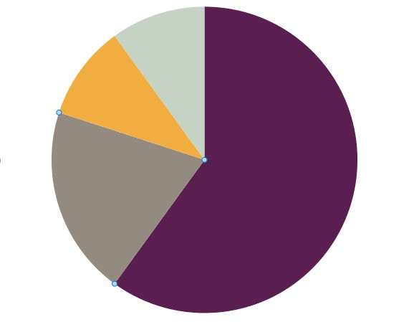
What we will ask you to do
Section
10%
Mid-quarter diagnostic
15%
End of quarter assessment
15%
Programming
60%

Slide 63
What we will ask you to do
Section
10%
Mid-quarter diagnostic
15%
End of quarter assessment
15%
Programming
60%

Slide 64
Programming assignments
There will be 6 total
A1: C++ Legs
A2: Using abstractions (abstract data structures)
A3: Recursion
A4: Defining the abstraction boundary itself
A5: Implementation-side of the abstraction boundary
A6: Real-world algorithms

Slide 65
Programming assignments
There will be 6 total
Graded on functionality and style using buckets
✓ Meets requirements, possibly with a few small problems

Slide 66
Programming assignments
There will be 6 total
Graded on functionality and style using buckets
✓+ Satisfies all requirements for the assignment ✓ Meets requirements, possibly with a few small problems ✓- Has problems serious enough to fall short of requirements

Slide 67
Programming assignments
There will be 6 total
Graded on functionality and style using buckets
++ Absolutely fantastic submission (extremely rare) + "Perfect" or exceeds our standard expectations ✓+ Satisfies all requirements for the assignment ✓ Meets requirements, possibly with a few small problems ✓- Has problems serious enough to fall short of requirements - Extremely serious problems, but shows some effort -- Shows little effort and does not represent passing work

Slide 68

Programming assignments
There will be 6 total
Graded on functionality and style using buckets
++ Absolutely fantastic submission (extremely rare) + "Perfect" or exceeds our standard expectations ✓+ Satisfies all requirements for the assignment ✓ Meets requirements, possibly with a few small problems ✓- Has problems serious enough to fall short of requirements - Extremely serious problems, but shows some effort -- Shows little effort and does not represent passing work
Why?

Slide 69
Programming assignments
There will be 6 total
Graded on functionality and style using buckets
48-hour grace period for each assignment
Most people will submit by the deadline. (“on-time” bonus)
The grace period is a free 48-hour extension that you can use if you have a particularly difficult week.

Slide 70
Programming assignments
There will be 6 total
Graded on functionality and style using buckets
48-hour grace period for each assignment

Slide 71
Programming assignments
There will be 6 total
Graded on functionality and style using buckets
48-hour grace period for each assignment
All deadlines are at 11:59pm PDT

Slide 72
What we will ask you to do
Section
10%
Mid-quarter diagnostic
15%
End of quarter assessment
15%
Programming
60%

Slide 73
Assessments
Mid-quarter diagnostic
Opportunity to evaluate your understanding of the core, fundamental topics from the first 3 weeks of the course
Designed to take 1.5 hours; completely open notes
Available to complete over a 72-hour time span from July 16-18
We’ll provide software for you to take the exam on your computer – once you open the file, you’ll have 3 hours to complete it
Post-exam feedback and self-reflection
End of quarter assessment

Slide 74
Section
Sign up by Tuesday at 5pm PDT at cs198.stanford.edu
Sections with remaining spots will open for signups after Wednesday at 9am PDT
Sections start this Wednesday!

Slide 75
How do I get help?

Slide 76

Trip Master Head TA tmaster@stanford.edu

Slide 77
Section Leaders
Frankie
Jin-Hee
Grant
Jose
Ryan
Ayelet

Slide 78

What the course staff do
Clarify conceptual material
Help you develop good debugging practices
Answer any administrative questions (Ask Trip & Susan for logistics)
Chat about CS and life in general!
We’re always happy to help you apply CS and the concepts you’ve learned in class to real-world applications/areas you’re interested in.

Slide 79
Resources for getting help
LaIR (general office hours)
Open Monday through Thursday (5-7PM PT M,W | 7-9PM PT T,Th)
Starts this Tuesday evening
Your section leader
Trip’s office hours
Susan’s office hours
Ed

Slide 80
Resources for getting help
LaIR (general office hours)
Your section leader
Trip’s office hours
Susan’s office hours
Please only sign up for one 15-min slot!
Ed

Slide 81
Resources for getting help
LaIR
Your section leader
Susan/Trip office hours
Ed

Slide 82
Resources for getting help
LaIR
Your section leader
Susan/Trip office hours
Ed
Conceptual question?

Slide 83
Resources for getting help
(C)LaIR
Your section leader
Susan/Trip office hours
Ed
Conceptual question?

Slide 84
Resources for getting help
LaIR
Your section leader
Susan/Trip office hours
Ed
Debugging help + code questions?

Slide 85
Resources for getting help
LaIR
Your section leader
Susan/Trip office hours
Ed
Administrative questions?

Slide 86
Resources for getting help
LaIR
Your section leader
Susan/Trip office hours
Ed
General CS + life questions?

Slide 87
Resources for getting help
LaIR
Your section leader
Susan/Trip office hours
Ed
When in doubt, check the Course Communication guidelines!

Slide 88
Resources for getting help
LaIR
Your section leader
Susan/Trip office hours
Ed
When in doubt, check the Course Communication guidelines!
The Summer Academic Resource Center (SARC) also offers tutoring and academic support separate from our course.

Slide 89
Announcements
Fill out your section time preferences by Tuesday at 5pm PDT.
Section signups should happen at the CS198 website
Make sure to check what time you’ve been assigned on Wednesday morning.
Finish Assignment 0 by Wednesday.
If you’re running into issues with Qt Creator, come to the Qt Installation Help Session tomorrow (Tuesday) at 7pm PDT AND Wednesday at 9am PT.
Assignment 1 will be released tomorrow! It will be due next week.

Slide 90
Announcements (II)
If you’ve already downloaded QT creator and are unable to run programs because of ”missing Stanford Libraries”, please check out the installation page again -- and be sure to follow the last step of the installation process (this is the step where you need to download and run the Stanford Libraries!)

Slide 91
Honor Code

Slide 92
Stanford’s Honor Code
All students in the course must abide by the Stanford Honor Code.
Make sure to read over the Honor Code handout on the CS106B website for CS-specific expectations.
Acknowledge any help you get outside course staff directly in your submissions.
We run code similarity software on all of your programs.
Anyone caught violating the Honor Code will automatically fail the course.

Slide 93

Textbook Options
The course textbook has excellent explanations of the course topics and is a great reference for C++ as we’ll use it in this course.
There’s also a draft version available online that you can use this summer.

Slide 94
Why C++?

Slide 95
How is C++ different from other languages?
C++ is a compiled language (vs. interpreted)
This means that before running a C++ program, you must first compile it to machine code.

Slide 96
How is C++ different from other languages?
C++ is a compiled language (vs. interpreted)
C++ gives us access to lower-level computing resources (for example, more direct control over computer memory)
This makes it a great tool for better understanding abstractions!

Slide 97
How is C++ different from other languages?
C++ is a compiled language (vs. interpreted)
C++ is gives us access to lower-level computing resources (for example, more direct control over computer memory)
If you’re coming from a language like Python, the syntax will take some getting used to.
Like learning the grammar and rules of a new language, typos are expected. But don’t let this get in the way of working toward literacy!

Slide 98
First C++ program!

Slide 99
The structure of a program
#include <iostream>
#include "console.h"
using namespace std;
// The C++ compiler will look for a function
// called “main”
int main() {
cout << "Hello, world!" << endl;
return 0; // must return an int to indicate
// successful program completion
}
import sys
# This function does not need to be called “main”
def main():
print('Hello, world!')
if __name__ == '__main__':
# Any function that gets placed here will get
# called when you run the program with
# `python3 helloworld.py`
main()
C++
Python

Slide 100
What’s next?

Slide 101




Applications of abstractions

Slide 102
Visit the course website at
https://cs106b8.stanford.edu
for access to materials:
Course Information
CS106B Calendar
Course Placement
CS106B and the Honor Code
Assignment 0

Slide 103
Roadmap
Object-Oriented Programming
C++ basics
Implementation
User/client
vectors + grids
stacks + queues sets + maps
arrays
dynamic memory management
linked data structures
real-world algorithms
Diagnostic
Life after CS106B!
Core Tools
algorithmic analysis
recursive problem-solving
testing

Slide 104
Roadmap
Object-Oriented Programming
C++ basics
Implementation
User/client
vectors + grids
stacks + queues sets + maps
arrays
dynamic memory management
linked data structures
real-world algorithms
Diagnostic
Life after CS106B!
Core Tools
algorithmic analysis
recursive problem-solving
testing

Slide 105
Goals for this Course
Learn how to model and solve complex problems with computers.
Explore common abstractions for representing problems.
Harness recursion and understand how to think about problems recursively.
Quantitatively analyze different approaches for solving problems.

Slide 106
Aero/Astro
African / Afro-American Studies
Bioengineering
Biology
Business
Chemical Engineering
Chemistry
Civil and Environmental Engineering
Classics
Computer Science
Creative Writing
Earth Systems
Economics
Education
Electrical Engineering
Energy Resource Engineering
English
Environmental Systems Engineering
Environment and Resources
Ethics in Society
Geophysics
Human Biology
Immunology
Individually-Designed
International Policy
International Relations
Law
Linguistics
Management Science and Engineering
Materials Science and Engineering
Mathematical and Computational Science
Mathematics
Mechanical Engineering
Music
Physics
Psychology
Public Policy
Science, Technology, and Society
Sociology
Symbolic Systems
Theater and Performing Studies
Undeclared!

Slide 107
Roadmap
Object-Oriented Programming
C++ basics
Implementation
We’re excited to go on this journey with you!
User/client
vectors + grids
stacks + queues sets + maps
arrays
dynamic memory management
linked data structures
real-world algorithms
Diagnostic
Life after CS106B!
Core Tools
algorithmic analysis
recursive problem-solving
testing

